Slide 1
Role of NRAs to incentivise DSOs
Manuel Sánchez Jiménez, PhD
Team Leader Smart Grids
Internal Energy Market – Retail Markets
DG ENER, European Commission

Slide 2
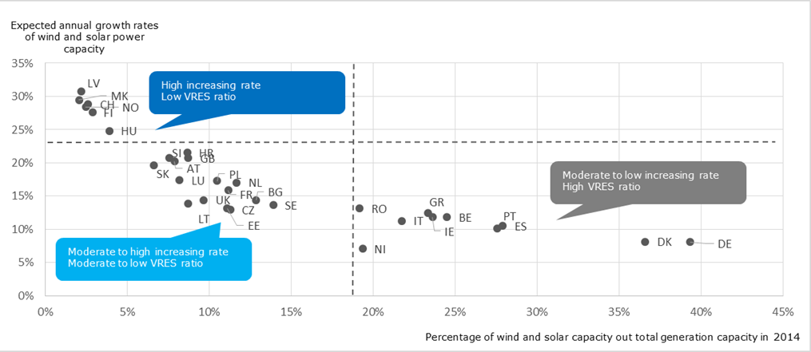
Distribution Networks
Impact assessment: Section 2.1 (Problem Area I), Annex 3.2
Electricity Directive: Articles 31, 32, 33, 34, 36
Wind and solar growth and ratio to total capacity
Wind and solar is on the rise with a large part connected to distribution grids
Notes:
Current situation
A large amount of variable RES E generation (i.e. wind and solar) are connected to distribution grids, a trend that is expected to continue in the future, depending of course to the level of RES penetration in each country.
The percentage of RES E connected to distribution is considerably high in some Member States (e.g. over 90% in DE, over 60% in BE, IE, IT, PT, UK, FR and around 50% in ES). Moreover, is expected that electrification of transport sector (a rapid penetration of electric vehicles is expected up to 2030, with Germany expected to have the higher number of around 10 mn EVs which correspond to around 1/4 of the passenger cars fleet), as well as new loads such as heating pumps, will put new requirements and constraints on the distribution grids.
2

Slide 3
Distribution Networks
Impact assessment: Section 2.1 (Problem Area I), Annex 3.2
Electricity Directive: Articles 31, 32, 33, 34, 36
Problem
Current framework at EU or national level does not:
... allow DSOs to be flexible and cope with variable RES and new loads
... clarify DSO role in specific tasks
Preferred option
Enabling framework for DSOs to procure and use flexibility
DSO tasks in storage, EVs infrastructure and data management
Cooperation between DSOs and TSOs alongside a EU DSO entity
Lower grid costs and tariffs
Neutrality of DSOs in new tasks
Notes:
Existing provisions of the Electricity Directive focus on main tasks of DSOs and unbundling rules. Current framework doesn't provide to DSOs the flexibility to handle future challenges in cost-effective way. Also doesn't focus on specific tasks of the energy transition.
Preferred and alternative options
Preferred option (Option 1) aim is to establish a clear legal basis for DSOs to use flexibility and clarify the role of DSOs in competitive activities such as storage and electric vehicles charging, as well as data handling. Moreover, cooperation with TSOs for coordinated operation of grids. Total savings at EU level from avoided distribution investments can be 3.5 to 5 bn EUR per year, or total 50 – 85 bn EUR from 2016 up to 2030. The alternative option (Option 2) foresees a uniform framework for DSOs in terms of tasks and level of unbundling across the EU. The procurement of flexibility from DSOs similar to Option 1.
Legislative proposal
DSOs to use distributed energy resources for the operation of their grids and managing congestions (Electricity Directive, Articles 31 and 32)
Conditions for involvement of DSO in electro-mobility, storage activities and data management (Electricity Directive, Articles 33, 34 and 36)
Cooperation between DSOs and TSOs (Electricity Regulation Articles 51, 53)
3

Slide 4
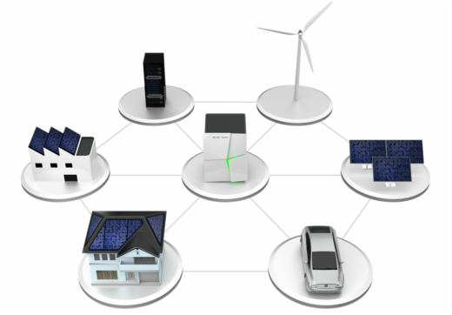
DSO use of flexibility
Electricity Directive: Articles 31, 32
Improve existing provisions that require DSOs to consider demand response, energy efficiency and distributed generation in grid planning
Allow DSOs to procure services (including non-ancillary) from distributed energy resources for managing local congestions and technical problems
Procurement through market based procedures, with definition of required products and technical modalities → level playing field
Member States to define the exact regulatory framework including incentives for DSOs and adequate remuneration
AIM:
Improve efficiencies in operation and development of network
Avoid unnecessary grid expansions → lower grid costs and tariffs
Notes:
4

Slide 5
DSO use of flexibility
Electricity Directive: Article 32
Distribution network development plans (Art. 32)
Distribution investments for the next 5 to 10 years
Emphasis on RES integration, new loads, use of flexibility
DSOs shall submit to the NRA every two years
(Member States may exempt from the obligation DSOs with less than 100.000 customers)
NRA to consult system users
Results of the consultation to be published
Transparency in network planning
Demonstrate use of flexibility and RES integration
Development of smart grids (Art. 59.1)
Notes:
5

Slide 6
Role of DSOs in EV recharging points
Electricity Directive: Article 33
National frameworks shall facilitate connection of recharging points and ensure cooperation of DSOs and EV recharging service providers
Electric vehicles infrastructure development should be developed mainly by commercial market parties
Member States may allow DSO involvement under conditions, within the framework of existing unbundling rules
Tender procedure / other market parties not interested
Regulatory approval
Reassess the market every 5 years
DSO to phase-out activities if market interest exists
Notes:
6

Slide 7
Role of DSOs in storage
Electricity Directive: Article 36
DSOs should not be allowed to own, develop, manage or operate storage facilities
Member States could derogate and allow DSOs to get involved:
If other parties are not interested to be involved in such activities
Only to ensure the reliable, efficient and secure operation of the distribution system
The unbundling rules remain unchanged
Open tendering procedure
Regulatory authority approval
Reassess the market every 5 years
DSO to phase-out activities if market interest exists
Notes:
7

Slide 8
Distribution network tariffs and DSO remuneration
Impact assessment: Section 2.1 (Problem Area I), Annex 3.3
Electricity Regulation: Articles 16 and 55 - Electricity Directive: Articles 32 and 59
Problem
In most cases DSO remuneration only favours network expansion solutions
Diversity of distribution tariffs create different market conditions for distributed resources across EU
Preferred option
EU-wide principles for distribution network tariffs
DSOs to prepare multiannual development plans
Efficient grid operation and planning
Support innovative solutions
Facilitate the integration of distributed resources
Notes:
Current situation
NRAs are responsible for setting/approving distribution tariffs. Remuneration for DSOs set or approved by regulators in the majority of Member States, while in most Member States final tariffs are also being set by the national regulator. There is a wide variety of remuneration schemes and tariff structures across the EU, which partly reflects the different situations and local conditions in Member States.
Preferred and alternative options
Preferred option (Option 1) in addition to the existing framework, measures on key EU-wide principles and guidance regarding the remuneration of DSOs, to incentivise efficient operation and planning of grids, also ensure fair distribution tariffs and facilitate the integration of distributed energy resources (e.g. storage facilities and self-generation). DSOs to prepare and implement multi-annual development plans. NRAs to implement more detailed transparency and comparability requirements for distribution tariffs methodologies. Alternative option (Option 2) to fully harmonize distribution tariffs at EU level, was rejected as one particular methodology cannot accommodate local conditions.
Legislative proposal
Principles on distribution tariff structures and incentives (Electricity Regulation, Article 16) - ACER Recommendation and Network Code on network tariffs (Electricity Regulation, Articles 16 and 55)
Development plans for distribution systems (Electricity Directive, Article 32) - Monitoring of distribution (and transmission) systems smart grid development and transparency of network tariffs (Electricity Directive, Article 59)
8

Slide 9
Distribution network tariffs
Electricity Regulation: Articles 16 and 55 - Electricity Directive: Article 59
Existing regulatory framework for fixing/approving distribution tariffs or methodologies remains unchanged
Additional principles for distribution network tariffs:
More explicit transparency requirements on regulatory authorities regarding tariff methodologies and underlying costs (Electricity Directive Art. 59.8)
Non-discrimination between generation connected to transmission and distribution (Art. 16.1 of Electricity Regulation)
Non-discrimination or disincentives against storage and demand response
Cost-reflective tariffs including the possibility of time-differentiated tariffs (Art. 16.7)
Regulatory authorities to provide incentives to DSOs for use of flexibility and innovation (Electricity Regulation Art. 16.8)
Notes:
9

Slide 10
Distribution network tariffs
Electricity Regulation: Articles 16 and 55 - Electricity Directive: Article 59
The proposal provides for more specific rules on network tariffs including distribution:
ACER recommendation (Electricity Regulation Art. 16.9)
network code on transmission and distribution tariff structures and connection charges (Electricity Regulation Art. 55.1)
Why?
Up to 90% of variable RES E generation is connected to distribution system
Network access conditions are an important element for the participation of distributed generation and other resources to national and cross-border markets
Uncoordinated policies may lead to diverse access conditions, affect the functioning of the internal market and the integration of RES
Notes:
10

Slide 11
Creating a level playing field for access to data
Impact assessment: Section 2.4 (Problem Area IV), Annex 7.3
Electricity Directive: Articles 23, 24 and 34
Current situation and problem
Smart metering systems, in 19 Member States → more granular consumption data and new services
Existing provisions in Electricity Directive not fit for new developments
Preferred option
Define responsibilities for parties involved in data handling
Set principles on non-discriminatory and transparent access to data
Support active consumer and new services
Facilitate switching and billing
Notes:
Current situation
In the majority of Member States the DSO is the responsible party for metering activity and smart meters, as well as for data access. However, regarding data access more recent information indicates that some Member States such as Finland and Sweden are planning a central data hub under the responsibility of the TSO, especially in Member States where there is a high number of DSOs (e.g. SE, FI).
Preferred and alternative options
Preferred option (Option 1) Member States will continue to be responsible for the development of the data management model; more explicit requirements to be introduced regarding responsibilities in data handling based on appropriate principles. Ensure impartiality and non-discriminatory behaviour of entities involved in data handling. Ensure a standardised data format in order to simplify retail market procedures and enhance competition. Alternative option (Option 2) considered to be less effective as it would entail full harmonisation of data management models across EU Member States.
Legislative proposal
Principles for data access (Article 23)
Certification and compliance of the responsible parties, including DSOs (Article 23 and 34)
Data format (Article 24)
11

Slide 12
Creating a level playing field for access to data
Electricity Directive: Articles 23, 24 and 34
National frameworks shall specify eligible parties for non-discriminatory access to data according with GDPR and ensure efficient data access and public available procedures
Member States or designated authority shall authorise and certify the parties to be involved in data management, and might request them the nomination of compliance officers
Regulated entities shall not profit for data services to other eligible parties
Member States may allow DSOs involvement in data management under specific measures to ensure the exclusion of discriminatory access to data from eligible parties and that vertically integrated undertaking do not have privileged access to data for the conduct of the supply activity
Ensure competition and privacy
Facilitate non-discrimination and transparent data flows among eligible parties
Notes:
12

Slide 13
Improving the institutional framework – EU DSO entity
Impact assessment: Section 2.1 (Problem Area I), Annex 3.4
Electricity Regulation: Articles 49 to 53
Current situation and problem
Distribution networks are gaining importance; however, DSOs are not formally represented in the EU institutional framework
Cooperation of DSOs and TSOs on a voluntary basis; however, a closer cooperation also in the context of network codes is required
Preferred option
Adapt the institutional framework to the new realities, including the establishment of a EU DSO entity
EU DSO entity to work in specific areas and cooperate with ENTSO-E
Notes:
Areas of work of EU DSO Entity
Coordinated operation and planning of transmission and distribution networks
Integration of distributed energy resources
Development of demand response
Digitalisation of distribution network and smart grids
Data management, cyber security, data protection
Participation in the elaboration of network codes
Cooperation with ENTSO-E in network codes and coordinated operation/planning of distribution and transmission grids
Legislative proposal
Establishment of a European entity for DSOs (Articles 49 and 50)
Specific tasks of the EU DSO entity, including participation in network code development and cooperation with TSOs (Articles 51, 52 and 53)
13

Slide 14
Questions
manuel.sanchez-jimenez@ec.europa.eu

