Slide 1
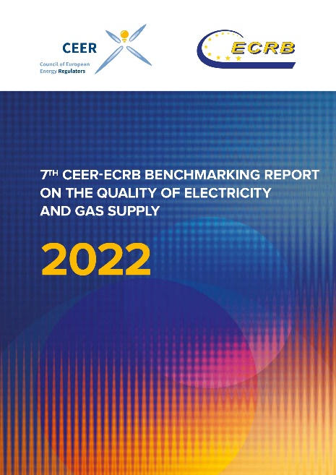
CEER-ECRB Second Webinar on the 7th Benchmarking Report on the Quality of Electricity and Gas Supply
15 September 2023
10:30-12:00 CET

Slide 2
CEER-ECRB Second Webinar on the 7th Benchmarking Report on the Quality of Electricity and Gas Supply

Slide 3
CEER-ECRB Second Webinar on the 7th Benchmarking Report on the Quality of Electricity and Gas Supply
Welcome and introductory remarks
Veli-Pekka Saajo (EV)
Chair of the CEER Distribution Systems Working Group

Slide 4
CEER-ECRB Second Webinar on the 7th Benchmarking Report on the Quality of Electricity and Gas Supply
Summary presentation of the 7th Benchmarking Report on Quality of Electricity and Gas Supply
Ognjen Radović (E-Control)
Co-Chair of the CEER Energy Quality of Supply Workstream

Slide 5
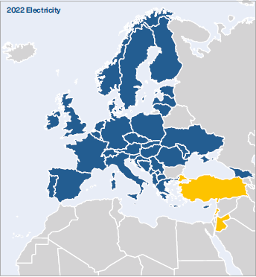
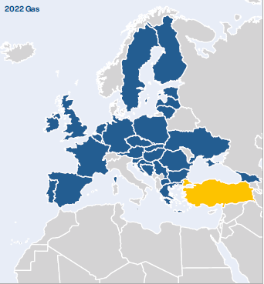
Background (1)
Since 2001, the Council of European Energy Regulators (CEER) has routinely surveyed, analysed and reported on the quality of electricity and (since 2016) gas supply in European countries, the results of which are presented in its Benchmarking Reports
Since then, the Benchmarking Report has gained importance and acknowledgement across Europe
The number of participating countries increased from 6 in the 1st edition to 39 in the 7th edition of the Benchmarking Report

Slide 6
Background (2)
For the first time, the report was co-written by the CEER and Energy Community Regulatory Board (ECRB) experts: specifically, the CEER Energy Quality of Supply Work Stream (EQS WS) and the ECRB Customers and Retail Markets Working Group (CRM WG)
As a major improvement and with the aim of providing an extended and more reliable database and expanding the number of participants, the Energy Community Contracting Parties are included in the main body of the report (instead of in an annex as before)
The 7th Benchmarking Report was published in December 2022

Slide 7
Structure of the Report
Introduction
Electricity – Continuity of Supply
Electricity – Voltage Quality
Electricity – Commercial Quality
Gas – Technical Operational Quality
Gas – Natural Gas Quality
Gas – Commercial Quality

Slide 8
Continuity of Supply
Electricity

Slide 9
Electricity Continuity of Supply
Continuity of supply (CoS) concerns interruptions in electricity supply
Interruptions can be: planned or unplanned, long or short, with or without exceptional events
CoS is usually described with indicators depicting the number of interruptions, unavailability (duration) and energy not supplied per year
SAIDI (minutes per customer per year) and SAIFI (interruptions per customer per year) are the two most common indicators

Slide 10
Main CoS findings (1)
Electricity CoS is monitored in all responding countries, but vast differences exist in the type of interruptions monitored, indicators used, their calculation and the voltage levels included in them
Interruptions originating on high and medium voltage are monitored in all countries where those voltage levels are defined, but there are significant differences in definitions of voltage levels across Europe
Unplanned interruptions are monitored in every responding country (regardless of whether legal obligations for monitoring exist) while planned interruptions are not
The monitoring usually covers long interruptions whereas less than half of respondents collect data on short or transient interruptions

Slide 11
Main CoS findings (2)
Excluding exceptional events, the majority of countries decreased or at least maintained their unplanned minutes lost and the number of interruptions per customer from the beginning to the end of the observed period (2010 to 2018). There are, however, exceptions to this observation
Large variations exist among the respondents:
Unplanned SAIDI (excluding exceptional events) ranges from 9 to 4,982 minutes per customer
Unplanned SAIFI (excluding exceptional events) ranges from 0.20 to 55.31 interruptions per customer
Planned SAIDI ranges from 0.23 to 5,144 minutes per customer
Planned SAIFI ranges from 0.00 to 45.47 interruptions per customer

Slide 12
Incentive regimes
The chapter on CoS also explores regulatory incentive regimes implemented at system and individual user level
Overall (system level) incentive-based schemes are in place in 19 responding countries. The majority are applied in distribution but there are also incentive schemes in transmission. Most countries use a combination of rewards and penalties, while very few respondents have regimes that focus exclusively on penalties. No country reported using only rewards in their continuity of supply incentive schemes
Individual compensation to customers is in place in two thirds of responding countries. In most cases, financial compensation is awarded if a single interruption or the total duration of yearly interruptions exceeds certain duration or if the yearly number of interruptions exceeds a certain limit. Compensation can be automatic or on customer request. Automatic compensation is offered in 14 countries

Slide 13
CoS recommendations
It is recommended to include all incidents at all voltage levels in interruption statistics
Harmonise the methodology to calculate CoS indicators. Common weighting methods and rules for aggregation of subsequent short interruptions should be introduced
Establish the definition of exceptional events in each country
Harmonise them at the European level in the interest of achieving comparable indicators
Apply adequate incentive schemes, if economically viable, in both distribution and transmission
Implement compensation payments (for each voltage and/or capacity level) for network users affected by very long interruptions

Slide 14
Voltage Quality
Electricity

Slide 15
Voltage Quality
Voltage Quality (VQ) covers deviations from optimum values in voltage magnitude or waveform
Everyone connected to the power grid could influence the quality of the voltage
Voltage disturbances are becoming an increasingly important issue due to the increasing susceptibility of end-user equipment and industrial installations
Examples of voltage quality disturbances: supply voltage variations (due to large load changes), voltage dips (due to short-circuits in the grid), voltage swells, flicker, harmonic voltage…
It is expected that the need for proper regulation of voltage quality will increase with distributed generation. Regulating VQ includes setting standards and minimum requirements, implementing rewards/penalties, publishing and setting obligations

Slide 16
EN 50160
European Standard EN 50160 gives an overview of all voltage quality disturbances and sets limits for many of them
All respondents apply the EN 50160 standard for voltage quality, or their requirements for VQ are based on this European standard. This ensures a harmonised understanding of VQ phenomena throughout Europe
There are countries, however, where additional requirements have been implemented, mainly to enforce stricter limits

Slide 17
Main VQ findings
Voltage quality is monitored in grids (either transmission or distribution but in most cases both) of 24 responding countries, but indicators that are monitored differ between them
The majority of respondents indicated that their system operators are obliged to measure voltage quality on request from end-users. In a few countries, the end-user must pay for this service
Most countries indicated that they have requirements for smart meters and that the meters allow the monitoring of voltage quality
In some countries, end-users are subject to compensation or a lower tariff if the standard for voltage quality is not met

Slide 18
VQ recommendations
It is recommended to inform the end-users of the VQ, either on their request or by publishing the VQ monitoring data
Education and awareness on how VQ issues might affect the network and consumers will contribute to reducing inconveniences due to voltage disturbances
With distributed generation and smart meter penetration growing at a fast pace, it is recommended to perform more investigations into the use of smart meters for VQ monitoring
Further investigate how VQ is influenced by distributed generation and prosumers

Slide 19
Commercial Quality
Electricity

Slide 20
Electricity Commercial Quality
Commercial Quality (CQ) is directly associated with transactions between electricity companies and customers. In other words, it is the speed and accuracy with which customer requests are handled
Commercial transactions between electricity companies and their customers are traditionally classified as follows:
Pre-contract transactions, such as information on connection to the network
Transactions during the contract period, such as billing, payment arrangements and responses to customer complaints

Slide 21
CQ Indicators Vs Standards
Distinction between Indicators and Standards
Indicators define a way to measure dimensions of service quality
Standards refer to the minimum level of quality, as defined by NRAs
NRAs can define Standards for Indicators or define Indicators without Standards

Slide 22
Types of CQ Indicators
There are 3 different types of CQ Indicators:
Guaranteed indicators (GI) refer to quality levels that must be met in each individual case. If not, a customer must be compensated
Overall indicators (OI) refer to a given set of cases and must be met with respect to the whole population in that set (often used for minimum level of performance such as: 90% of new customers have to be connected to the grid within 2 weeks). A penalty is paid in case of non-compliance
Other requirements (OR) are additional requirements issued by NRAs to achieve a certain level of quality. If not met, NRAs could impose sanctions

Slide 23
Main electricity CQ findings
There is an increased focus on the quality of services provided to customers. According to analysis for this report, 21 different indicators are used in electricity, with network connection and time to respond to customer complaints being the most important. Most commercial quality obligations focus on DSOs
Progresses in harmonisation have been achieved compared to previous CEER Benchmarking Reports
There is a general trend over time to move toward Guaranteed Indicators (GIs) for which customers must receive compensation (subject to certain exemptions) if the required service level is not provided. Compensations can be paid automatically or on customer request
Commercial quality in electricity is mainly focused on residential customers connected to low voltage (LV) network because they represent the largest group and because small domestic customers often need more protection

Slide 24
Electricity CQ recommendations
Ensure greater protection through GIs with automatic compensation for customers
For the most important indicators (e.g. for connection activities), a combination of OIs with economic sanctions (like penalties) and GIs is recommended
Automatic compensation, which is increasingly applied, should be extended to every country
In many countries, indicators consider only written forms of communication (letters), which provides an incomplete picture of the CQ. Other forms of communication such as telephone and email should also be considered

Slide 25
CEER-ECRB Second Webinar on the 7th Benchmarking Report on the Quality of Electricity and Gas Supply
Summary presentation of the 7th Benchmarking Report on Quality of Electricity and Gas Supply
Michael Westermann (BNetzA)
Co-Chair of the CEER Energy Quality of Supply Workstream

Slide 26
Technical Operational Quality
Gas

Slide 27
Gas Technical Operational Quality
In general, no differences between quality of supply regulation of gas and electricity networks
But the characteristics of this commodity are very different
Since gas is a natural resource its quality and composition is of particular importance
Moreover, technical safety is of much higher importance
Interruptions in gas are much less common than those in electricity due to greater efforts to avoid them

Slide 28
Gas Technical Operational Quality Findings (1)
Indicators used for CoS and technical safety vary distinctly across Europe
Although there is general availability of information on CoS indicators, the level of detail shows huge differences
Technical safety plays a very important role in the gas sector with indicators, such as leaks, used to describe the technical quality of the infrastructure
Odorisation improves safety and is required in most European countries
In 28 countries DSOs have some obligations regarding gas odorisation
Is part of risk management

Slide 29
Gas Technical Operational Quality Findings (2)
Gas storage infrastructure – when used – is regulated in only about half of the countries
Gas storage facilities are used in 19 countries and regulated in ten
While writing the report, LNG infrastructure was used in 12 responding countries and regulated in ten

Slide 30
Gas Technical Operational Quality Recommendations
It is recommended to expand the coverage of monitoring of CoS and safety indicators
Promote a further harmonisation of the methodologies of calculating these indicators
Foster further developments of the LNG infrastructure

Slide 31
Natural Gas Quality
Gas

Slide 32
Natural Gas Quality – Remarks & Findings (1)
Summary of technical parameters and overview of definitions and applications in the reporting countries
In Austria and Germany, parameters are not monitored by NRAs but defined by technical associations (OVGW and DVGW)
Different purpose of natural gas parameters
Some natural gas parameters represent the chemical composition of natural gas (methane, sulphur, carbon dioxide,…)
Other parameters such as Wobbe Index, relative density or water/hydrocarbon dew point are considered important quality parameters

Slide 33
Natural Gas Quality – Remarks & Findings (2)
Monitoring of indicators
A majority of countries monitor gross calorific value (24 countries), water/hydro dew point (22 countries) and Wobbe index (22 countries)
Wobbe index as a main indicator of the interchangeability of fuel gases is used to compare the combustion energy output with different composition of fuel gases
Many countries already rely on CEN standard EN16726, though not being legally binding
This might contribute to reducing restrictions in cross-border gas flows and increasing the commercial market efficiency

Slide 34
Commercial Quality
Gas

Slide 35
Gas Commercial Quality
Gas Commercial Quality was first evaluated in the 6th BR
Commercial Quality covers the speed and accuracy with which customer requests are handled
Indicators of Gas CQ are usually classified into different groups covering customer related aspects

Slide 36
Gas Commercial Quality Findings (1)
A broad and increasingly harmonised range of indicators is monitored
Significant differences concerning the nature and the number of indicators across countries
NRAs set the Commercial Quality regulations according to their national, political, cultural and economic specificities
It is worth noting that NRAs apply identical or similar regulations concerning Commercial Quality indicators
Commercial Quality requirements vary greatly depending on the customer type, pressure levels, or on the company involved

Slide 37
Gas Commercial Quality Findings (2)
There is an increased focus by NRAs on the quality of services provided to customers
CQ is mainly focused on the DSO’s relationship with customers
There is a general trend towards the use of Guaranteed Indicators for which customers must receive compensation
Regulation of these GIs shows clear variations in terms of what compensations are paid and how they are paid (automatically/on customer request)

Slide 38
Gas Commercial Quality Recommendations (1)
Perform regular reviews of national regulations
One of the most important factors in this process is the availability of wide and reliable data
Review if additional indicators should be monitored
Pursue a further harmonisation of CQ indicator definitions
Harmonising the definitions would facilitate a more consistent and understandable database and
Enables an easier analysis of the results and identification of further possible improvements and recommendations

Slide 39
Gas Commercial Quality Recommendations (2)
NRAs should monitor indicators in all forms of communication for more accurate performance levels
Attention should be paid not only to the speed but also to thoroughness and usefulness of a response

Slide 40
Thank you for your attention!
www.ceer.eu

Slide 41
CEER-ECRB Second Webinar on the 7th Benchmarking Report on the Quality of Electricity and Gas Supply
Stakeholder feedback
Niels Van Nuffel (CEDEC/Fluvius)
Olivier Arrivé (ENTSO-E/RTE)
Fernando Dominguez (EU DSO Entity)

Slide 42
CEER-ECRB Second Webinar on the 7th Benchmarking Report on the Quality of Electricity and Gas Supply
Stakeholder feedback
Niels Van Nuffel (CEDEC/Fluvius)
Olivier Arrivé (ENTSO-E/RTE)
Fernando Dominguez (EU DSO Entity)

Slide 43
2nd webinar on the 7th Benchmarking Report
Feedback Fluvius (member of CEDEC)
September 15, 2023

Slide 44
Fluvius is a distribution grid operator.
We cover all Flemish towns and municipalities.
We build and manage the public utility lines in the street that bring electricity, natural gas, sewerage and heat
to our customers.
heating grids
sewerage
15
towns and municipalities
85
towns and municipalities
natural gas, public lighting and electricity
300
towns and municipalities
we manage
7.5 million
connections

Slide 45
Comments on the 7th Benchmarking Report
From a Distribution System Operator (DSO) perspective, the 7th Benchmarking Report provides valuable insights into the quality of electricity and gas supply across European countries
Standardization and Consistency
Support the importance of standardization and consistency in data collection and reporting methodologies.
Highlight that standardization will enable more meaningful comparisons and improve the accuracy of benchmarking results.
Indices relative to connections or grid length provide meaningful comparisons.

Slide 46
Comments on the 7th Benchmarking Report
Continuity of Supply (CoS):
Support harmonizing the definitions of supply interruptions and including all voltage levels in
interruption statistics.
Stress the importance of standardized definitions and methodologies for CoS assessment.
Recognize the importance of using multiple CoS indicators for a comprehensive assessment.
Consider the impact of Asset Management and investment decisions when assessing CoS, e.g. overhead lines, digitalization,..
Large-scale initiatives like the rollout of smart meters can significantly influence indices related to CoS.
Acknowledge the inclusion of gas in CoS monitoring. Use of similar time series or boxplots as in electricity data could provide valuable insights.

Slide 47
Comments on the 7th Benchmarking Report
Voltage Quality (VQ) and Smart Metering:
Endorse the report's emphasis on monitoring VQ and leveraging smart meters.
Emphasize that smart meters offer valuable data for enhancing VQ management and customer
satisfaction.
Express commitment to exploring smart metering technologies further.
Gas Supply Safety:
Acknowledge the importance of gas supply safety.
Recognize the significance of gas odorization in early gas leak detection and prevention of dangerous incidents.
Natural Gas Quality:
Recognize the need for monitoring and maintaining natural gas quality.
Highlight that complaints related to natural gas quality issues are infrequent.

Slide 48
Comments on the 7th Benchmarking Report
Commercial Quality:
Confirm dedication to improving the quality of services provided to customers.
Further harmonisation could enable more meaningful comparisons.
Mention higher awareness of customers due to energy crisis and higher prices
Customer Service:
Value customer feedback and its role in enhancing service quality.
Mention readiness to conduct satisfaction surveys and evaluate customer priorities.

Slide 49
Comments on the 7th Benchmarking Report
Regulatory and Policy Implications:
Stress the importance of closely monitoring regulatory changes and policy recommendations.
Emphasize the commitment to collaborating with regulatory authorities to ensure compliance
and operational efficiency.
Benchmarking and Best Practices:
Express appreciation for the report's insights into benchmarking and best practices.
Emphasize the intention to apply these insights to improve supply quality and customer satisfaction.

Slide 50
Suggestions for the next benchmarking report
Emerging Technologies:
Suggest incorporating a section on emerging technologies and innovations in the energy sector
that have the potential to impact supply quality.
Smart Metering for Gas:
Recommend the inclusion of a dedicated section on the adoption and benefits of smart metering for gas.
Explore how smart meters can enhance gas supply quality and customer satisfaction.
Environmental Impact:
Explore the environmental impact of supply interruptions and voltage quality issues, and how improving supply quality can contribute to sustainability goals.
Enhanced Reporting Format:
Consider adopting an interactive or web-based reporting format that allows for dynamic data visualization, making it easier for stakeholders to explore and understand the data.

Slide 51
Visit our website
www.fluvius.be
Whether it's in your street, at the office, at the sports club or at home: we come 'to you’ (Tot bij u).

Slide 52
CEER-ECRB Second Webinar on the 7th Benchmarking Report on the Quality of Electricity and Gas Supply
Stakeholder feedback
Niels Van Nuffel (CEDEC/Fluvius)
Olivier Arrivé (ENTSO-E/RTE)
Fernando Dominguez (EU DSO Entity)

Slide 53
CEER-ECRB Second Webinar on the 7th Benchmarking Report on the Quality of Electricity and Gas Supply
Stakeholder feedback
Niels Van Nuffel (CEDEC/Fluvius)
Olivier Arrivé (ENTSO-E/RTE)
Fernando Dominguez (EU DSO Entity)

Slide 54
CEER – Second webminar on the 7th Benchmarking report on the Quality of Electricity and Gas supply Fernando Dominguez – DSO Entity 15 September 2023

Slide 55
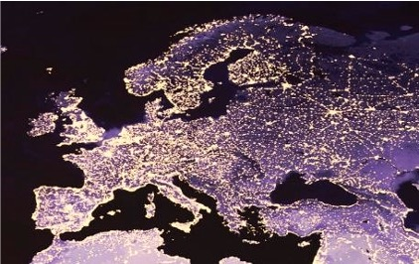
Clean Energy Package 2019: historic opportunity to generate a strong voice for DSOs in the EU
An EU association legally mandated by EU Regulation 2019/943
A body of cooperation and expertise between all DSO in the EU
“
Art. 52.1: Distribution system operators shall cooperate at Union level through the EU DSO Entity, in order to promote the completion and functioning of the internal market for electricity, and to promote optimal management and a coordinated operation of distribution and transmission systems.
900+ DSOs
connecting
250 million customers in the EU
“

Slide 56
EU Regulation 2019/943 (Art. 55) gives DSO Entity a clear mandate: three pillars
Network Codes & Guidelines
DSO/TSO cooperation
Sharing best practice
Participates in drafting of Network Codes and Guidelines relevant for DSO grids
Promotes optimal and coordinated planning and operation of DSO/TSO networks
Expert Groups and forum provide expertise and enable exchange of views
Joint proposal with ENTSO-E on NC Cybersecurity (1/22)
Works on new NC Demand Response (3/23)
Review of existing NC (e.g. grid connection codes)
MoU with ENTSO-E on general cooperation
DSO-TSO Work Plan (2022-23)
Intensive cooperation on all Network Codes
DSO Entity only association with DSOs from all EU-27
Intensification internal discussion and external communication of best practices
As of 1 June: new Website

Slide 57
Slide 0: Congratulations for a huge and robust report!!

Slide 58
High level messages on CEER’s recommendations
Quality as part of a bigger puzzle
Harmonisation vs standardisation
Quality measures/incentives and regulation
Quality improvement is only possible if pressure is put on the right actor - education

Slide 59
Quality as part of a bigger puzzle
The report focuses on outcomes and associated incentives/rewards but…what is the effect of the other components on quality?
Should the analysis consider a broader analysis of regulation?
WACC allowance
Recovered over time
RAB
Depreciation
Price control
Cost allowance
Recovered on year
Regulated revenues
Rewards and penalties

Slide 60
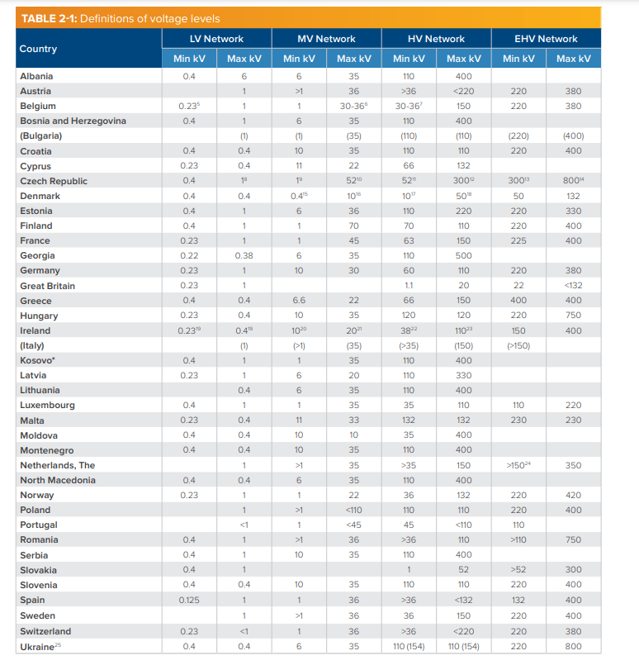
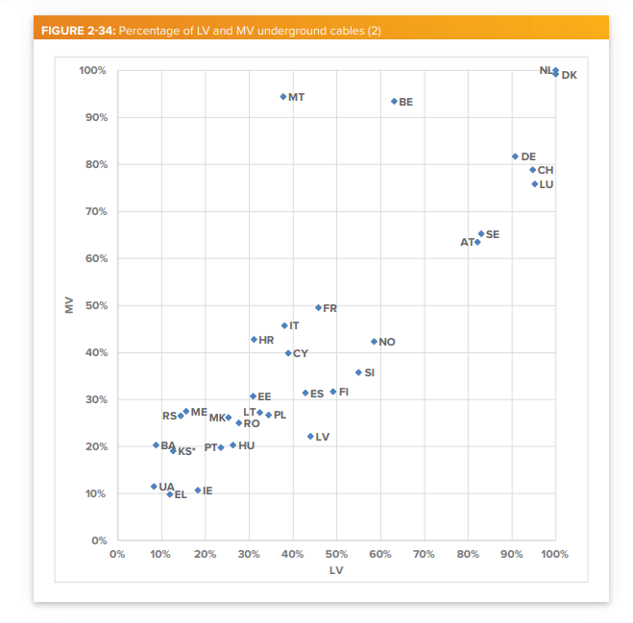
Harmonisation vs standardisation
Fully standardised definitions
Fully separated definitions
Harmonisation
The report encourages harmonization of the quality measures across countries but… could/should we obtain full standardization? Use this information for regulatory purposes?
Different network definitions
Different network characteristics
And many more such as:
the average age of the assets
History of the country
…

Slide 61
Quality measures/incentives and balancing the effects of regulation
Quality measures can diverge between countries for multiple reasons (technical, policy, awareness, historical…)
Harmonisation of measures could facilitate comparison.
However, to keep the balance harmonised measures could need to substitute old metrics.
Incentives focus on direct compensation to consumers.
If more quality dimensions receive financial penalties, companies will need more complex monitoring and payment systems.
However, to keep the balance some of these quality measures penalties could be combined into one single incentive mechanism.
Potential effects on complexity
Incentives remain based on direct payments
New metrics vs old metrics
The report considers harmonization of measures and quality incentives but…could we consider proposals on the round?
Notes:
© Copyright PresentationGO.com – The free PowerPoint and Google Slides template library
Icon made by Freepik from www.flaticon.com

Slide 62
Quality improvement is only possible if pressure is put on the right actor - education
The report identified:
the need for educating consumers on voltage issues to minimize risks; and
that consumer quality is still mainly focused on the DSO’s relationship with customers.
This education would facilitate consumers’ awareness of the effect they have on their grid and the new opportunities they face.
Therefore, general education for consumers on their role is a win-win…should we start identifying good practices?

Slide 63
CEER-ECRB Second Webinar on the 7th Benchmarking Report on the Quality of Electricity and Gas Supply
Stakeholder and audience questions

Slide 64
CEER-ECRB Second Webinar on the 7th Benchmarking Report on the Quality of Electricity and Gas Supply
Closing remarks
Martina Schusterova
CEER Deputy Secretary General

Slide 65
Thank you for your attention!
www.ceer.eu
www.energy-community.org

