Slide 2
Opening Remarks
Welcome
Annegret Groebel
President, CEER

Slide 3
Emergency Measures: How to cope with high energy prices
SESSION ONE
Video Address by
Kostyantyn Uschapovskyi
Chair, neurc

Slide 4
Video Address by Kostyantyn Uschapovskyi, Chair OF THE National Energy and Utilities Regulatory Commission OF UKRAINE (NEURC)
ACCESS THE Video

Slide 5
Emergency Measures: How to cope with high energy prices
SESSION ONE
Moderated by
Dennis Hesseling
Head of department infrastructure, gas and retail, acer
Session One Panellists
Pedro Verdelho
VICE PRESIDENT, CEER and ACER/CEER GAS WORKING GROUP CHAIR
Monique Goyens
DIRECTOR GENERAL, BEUC
Vincenzo Ranieri
PRESIDENT, EU DSO Entity

Slide 6
Emergency measures: how to cope with high energy prices
CEER Annual Conference
13 December 2022 - Brussels
Dennis Hesseling, Head of Infrastructure, Gas & Retail

Slide 7
Gas and electricity supply challenges drive prices up
Electricity & natural gas price evolution, 2021-2022 (Month Ahead)
Source: ACER calculation based on Platts price data

Slide 8
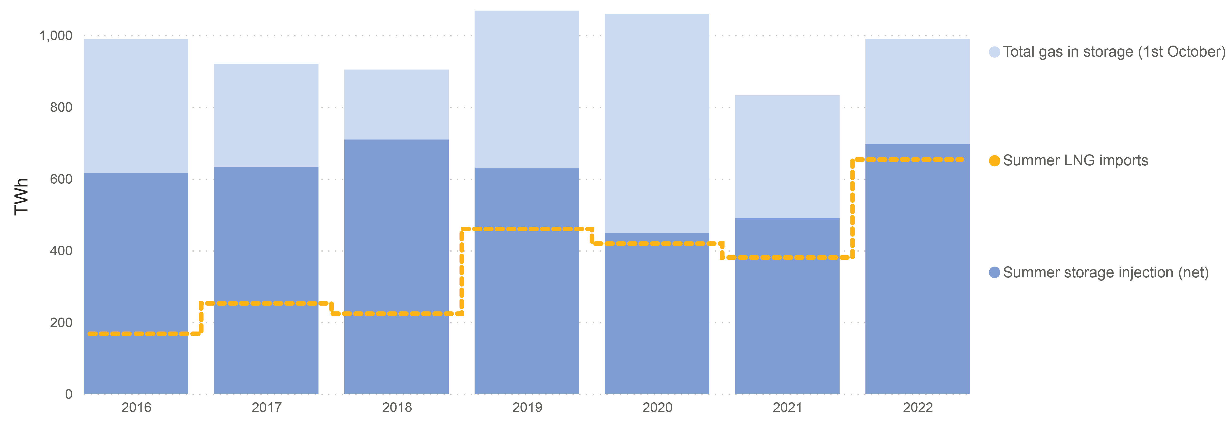
Current gas storage ‘success’ has come with a price
EU¹ gas storage build and LNG imports – April to October (2016 - 2022)
Record LNG imports to the EU (+56%²) achieved by sourcing cargoes at a premium to other global buyers
Strong competition for gas to fill storage has contributed to high spot prices at EU hubs
After significantly higher injections than in 2021, EU gas storages are currently 95% full but reportedly at eight times historical costs (est. 50 billion euros).
Source: GIE (storage status as of 20 November 2022), Reuters
Notes: (1) EU 27; (2) compared with average imports in corresponding months between 2019 and 2021

Slide 9
… and price expectations for coming years remain high
Evolution of gas (TTF) forward prices comparing the contractual outlook (October 2021 - November 2022)
Source: ACER calculation based on ICE

Slide 10
In turn, impacting record high retail prices
Average EU electricity and gas prices for median* EU household consumer
Russia’s invasion of Ukraine
Acceleration of Covid-19
Notwithstanding various government interventions, final retail prices saw steep increase.
*Median is the value separating the higher half from the lower half of a data sample, a population, or a probability distribution.
Source: VaasaETT

Slide 11
Energy expenditure impacting households
Household expenditure in gas and electricity as a total of household budget
By way of example, gas expenditure of households significantly increased (more than 10% in 9 countries). Electricity expenditure accounts for more than 5% of household income in 9 countries.
Source: VaasaETT, Eurostat. Analysis: VaasaETT

Slide 12
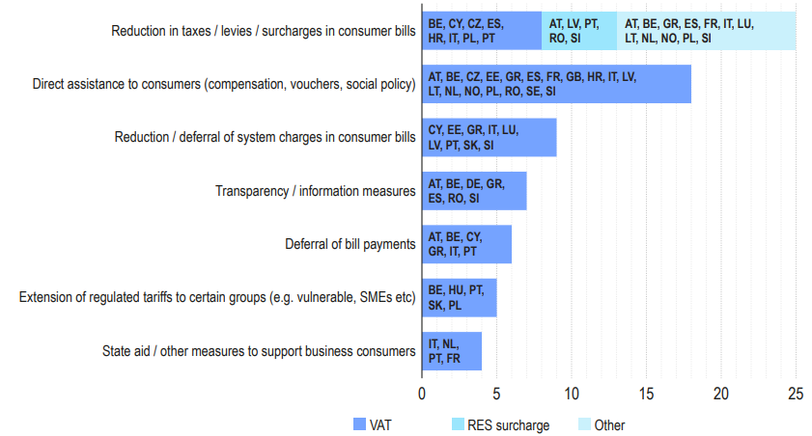
Ongoing assistance to vulnerable consumers
Support measures provided to consumers – 2022
# of countries
To date EUR 500 bn+ spent on support measures for consumers.
Source: ACER-CEER Market Monitoring Report (Retail and Consumer Protection volume); Bruegel

Slide 13
Poll question
Question: has the EU done enough to address the high energy prices?
Yes
No, it should have done more
No, it should have done less

Slide 14
Emergency Measures: How to cope with high energy prices
SESSION ONE
Questions from the audience

Slide 15
See you again in 20 minutes
Break

Slide 16
Market Design: Long-term adjustments or tweaks?
SESSION two
Moderated by
Annamaria Marchi
Deputy head of unit, internal Energy market (ENER.C.3), DG ENER, European Commission
Session Two Panellists
Christine Materazzi-Wagner ACER/CEER ELECTRICITY WORKING GROUP CHAIR
Kjell Arne Bramsnes CHAIR OF MARKET COMMITTEE, ENTSO-E
Mark Copley CEO, EFET
Bram Claeys SENIOR ADVISOR POWER MARKETS, RAP
Rafael Gómez-Elvira González CHAIR, NEMO COMMITTEE

Slide 17
CEER Annual Conference Electricity Market Design
Christine Materazzi-Wagner, CEER/ACER Electricity Working Group Chairperson

Slide 18
The electricity world changes anyway
The future electricity system will
be dominated by (volatile) renewables in the generation mix, with the remaining part being flexible
see a more active distribution system (distributed generation, demand response etc.)
will remain centralised to some extent (nuclear, hydro, offshore)
feature a higher level of electrification (heating/cooling, industrial processes, transport)
be shaped by digitalisation
be integrated with other sectors (hydrogen, biogas; heat, transport))
The best market design for a high-performance electricity system
Affordability and resilience
Market segments
Time horizons / implementation periods

Slide 19
Electricity Market reform, beyond the gas crisis
13/12/2022
CEER Annual Conference, Brussels

Slide 20
Electricity market reform goals Transition away from fossil gas
More and faster solar, wind
Demand side flexibility made a proper resource
Protected basic consumer needs

Slide 21
Reform for affordable energy transition at speed
Supply side
More, faster, better renewables
Demand side
Resource on par with supply
People centric
Develop offshore energy and improve long-term markets.
Deliver full access for demand side flexibility to all markets.
Hedge consumers
Offer smart tariff options
Grids
Performance-based regulation
Wholesale market foundation
Better price formation
Independent System Operation
Robust wholesale market foundation - Comprehensive price formation: marginal, scarcity, location signals - Coupled markets via interconnectors and transmission - Governance neutrality: Independent System Operation
Private financing
Public financing
Windfall profit tax

Slide 23
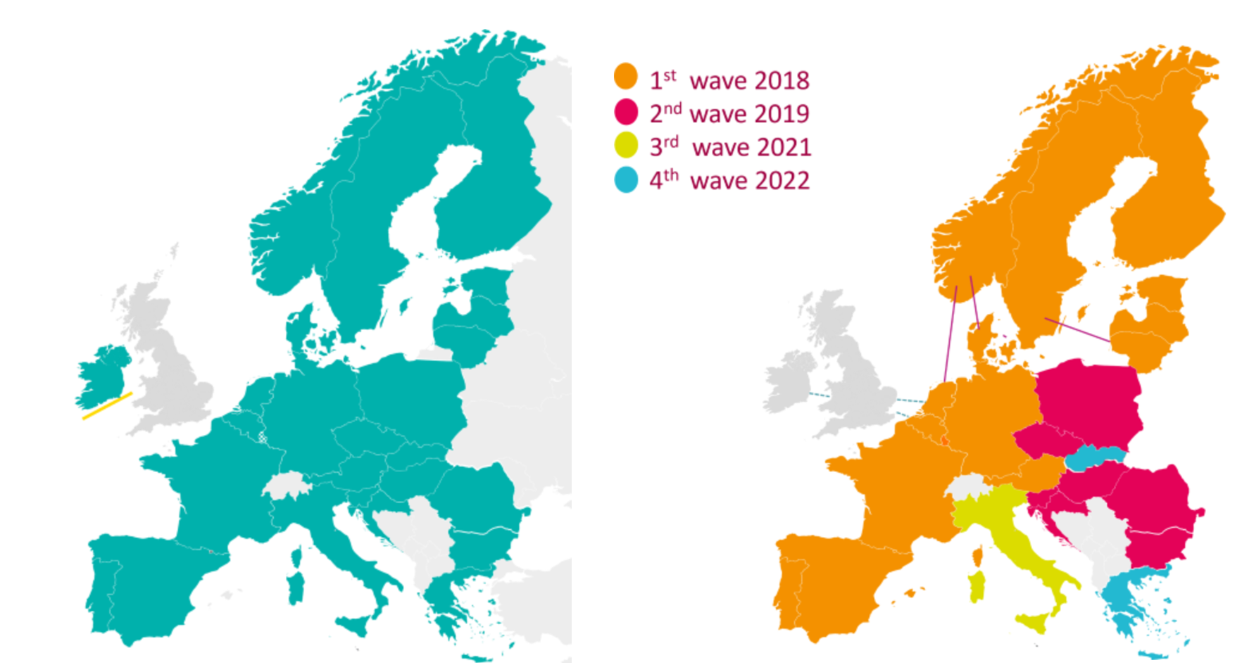
www.nemo-committee.eu
SDAC
SIDC

Slide 24
Market Design: Long-term adjustments or tweaks?
SESSION two
Questions from the audience

Slide 25
Closing Remarks
Alda Ozola
ViCE President, CEER

