Slide 1
Integrating Renewables into the Market - Effects and Implications
Fernando Hernández, CEER Electricity Working Group Chair
CEER Annual Conference 2017

Slide 2
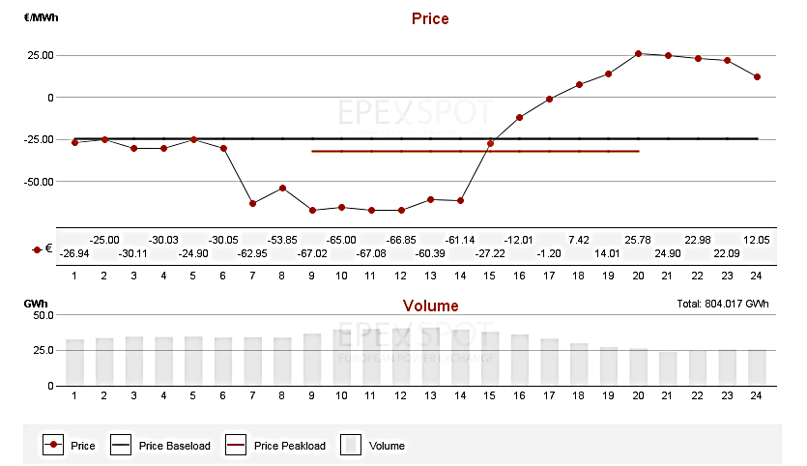
Impact of Renewables
Negative prices 1st May 2017 (DE-AT Price Zone)
Source: EPEX-SPOT
Notes:
The overall aim of the Council of European Energy Regulators (CEER) is to facilitate the creation of a single, competitive, efficient and sustainable internal market for gas and electricity in Europe.
CEER acts as a platform for cooperation, information exchange and assistance between Europe's national energy regulators and is their interface at EU and international level. On EU issues, CEER works very closely with (and supports) the Agency for the Cooperation of Energy Regulators (ACER).
CEER actively promotes an investment-friendly and harmonised regulatory environment, and consistent application of existing EU legislation.
CEER also strives to share regulatory best practice worldwide through its membership in the International Confederation of Energy Regulators (ICER).

Slide 3
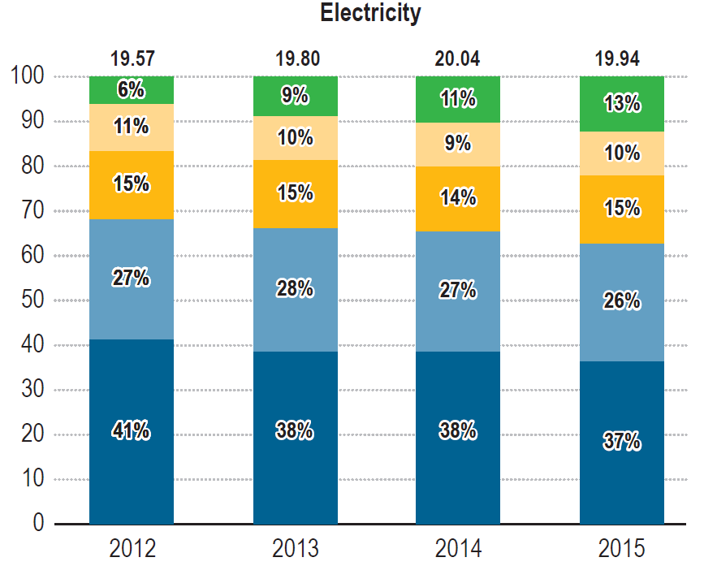
Impact of Renewables
ACER/CEER MMR: retail prices falling again, except for elec HH
  Lowers wholesale prices, feeding into consumer bills
  RES subsidies and other levies are an issue!

Slide 4
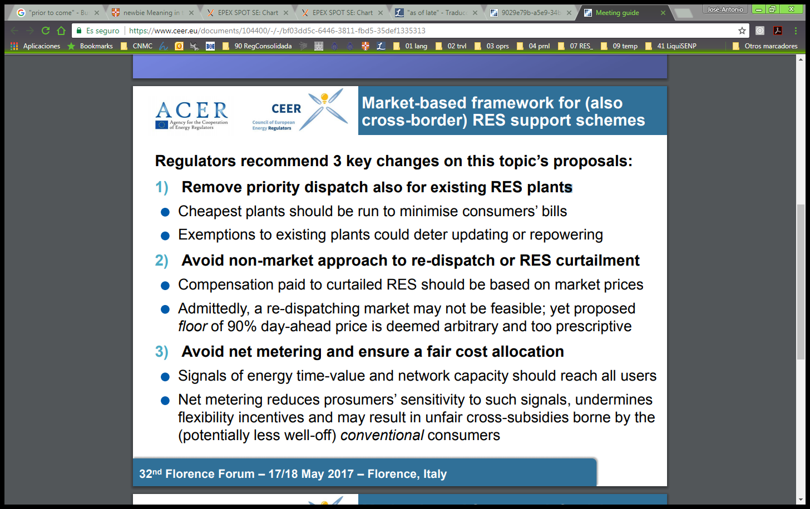
CEER’s Clean Energy Positions
Notes:
The overall aim of the Council of European Energy Regulators (CEER) is to facilitate the creation of a single, competitive, efficient and sustainable internal market for gas and electricity in Europe.
CEER acts as a platform for cooperation, information exchange and assistance between Europe's national energy regulators and is their interface at EU and international level. On EU issues, CEER works very closely with (and supports) the Agency for the Cooperation of Energy Regulators (ACER).
CEER actively promotes an investment-friendly and harmonised regulatory environment, and consistent application of existing EU legislation.
CEER also strives to share regulatory best practice worldwide through its membership in the International Confederation of Energy Regulators (ICER).

Slide 5
CEER’s Clean Energy Positions
Renewable self-consumers and local energy communities:
  We support active consumers / prosumers
  However, consumer involvement should be voluntary with consumer rights protected
  Important to prevent cross-subsidies between active and inactive/vulnerable: use cost-reflective network tariffs and avoid net metering
Facilitate more demand-side flexibility and participation
TSO/DSOs coordination and minimise RES curtailment
Notes:
The overall aim of the Council of European Energy Regulators (CEER) is to facilitate the creation of a single, competitive, efficient and sustainable internal market for gas and electricity in Europe.
CEER acts as a platform for cooperation, information exchange and assistance between Europe's national energy regulators and is their interface at EU and international level. On EU issues, CEER works very closely with (and supports) the Agency for the Cooperation of Energy Regulators (ACER).
CEER actively promotes an investment-friendly and harmonised regulatory environment, and consistent application of existing EU legislation.
CEER also strives to share regulatory best practice worldwide through its membership in the International Confederation of Energy Regulators (ICER).

Slide 6

www.ceer.eu

